Slide 1
ME 315 SLP
Vibration Suppression Control of Robotic Arms
Industry Guide: Prof Ishwar Singh, McMaster University, Canada
Faculty Guide: Prof Abhishek Gupta, IIT Bombay, India
– Saayuj Deshpande

Slide 2
Problem Statement
Robotic arm at robotics startup - AXIBO:
6-axis
BLDC motors
Harmonic reducers
Initial Task:
Reduce vibrations faced by the arm at certain configurations and certain velocities

Slide 3
Approach
As studied in ME 604:
Made a schematic of the arm
Computed singularities
Conducted research on:
Harmonic drives - Transmission error
BLDC motors
Field-oriented control
Concluded: Longest link (1m) affected the most by vibrations
Proceeded to simulate assembly using Simscape

Slide 4
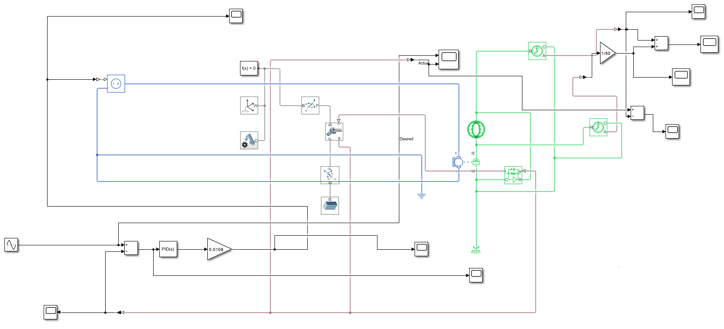
Modeling the Longest Link Assembly
Simulation contains:
DC motor
Harmonic drive
Link (Al - 0.1*0.1*1 m³)
PID control loop
Fig: Simulation of entire assembly

Slide 5
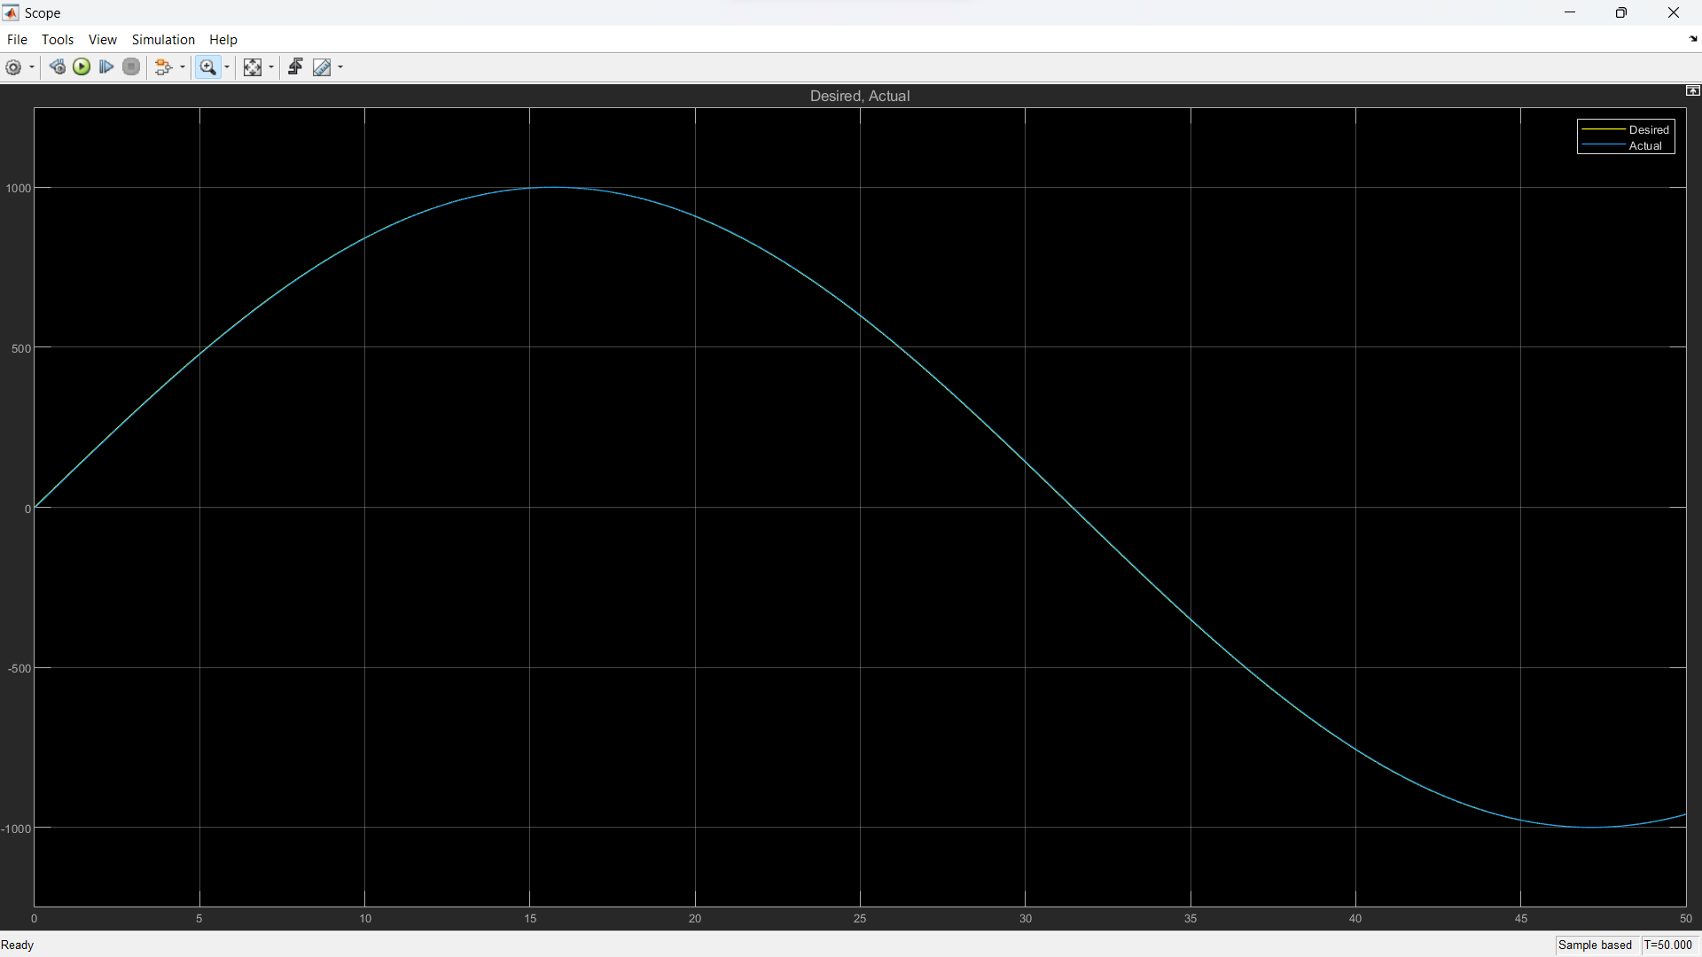
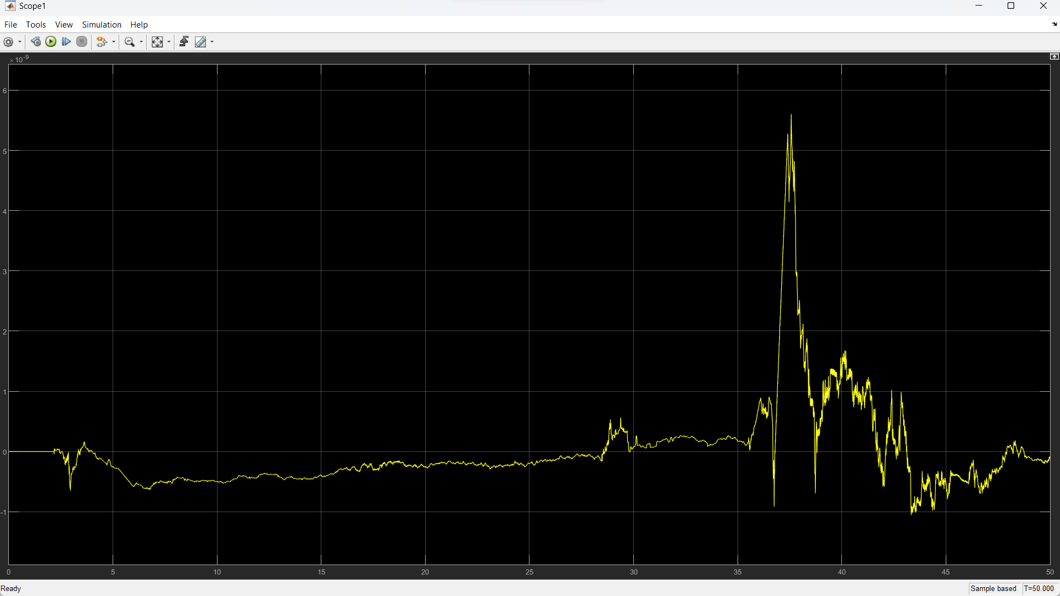
Results
Fig: Velocity tracking
Fig: Transmission error

Slide 6
Discussion
Vibration directly related to transmission error
Transmission error = Difference between input and output displacements of harmonic drive
Transmission error insignificant: order of 1e-9 rad; not realizable in real world
Studies inconclusive - we study harmonic drive separately

Slide 7
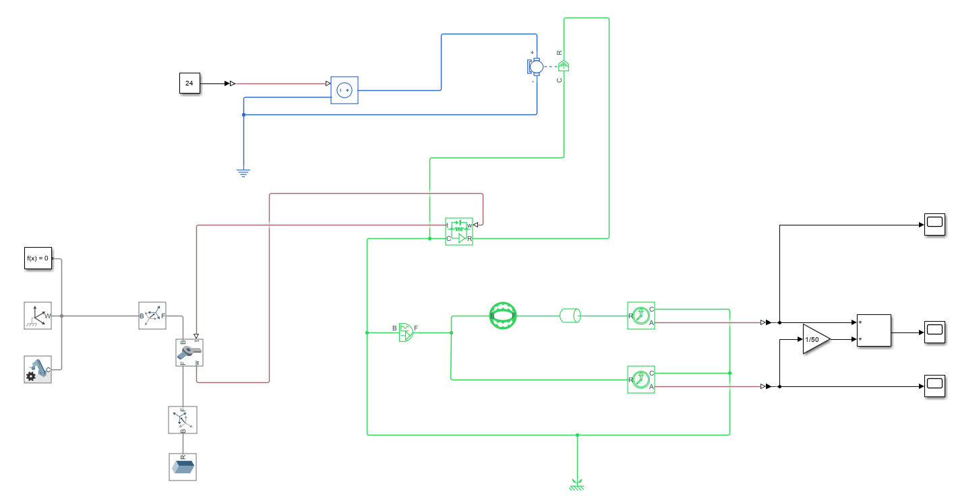
Modeling only Harmonic Drive
Salient features:
Motor replaced with ideal velocity source (sinusoidal)
Harmonic drive isolated
Fig: Simulation of harmonic drive

Slide 8
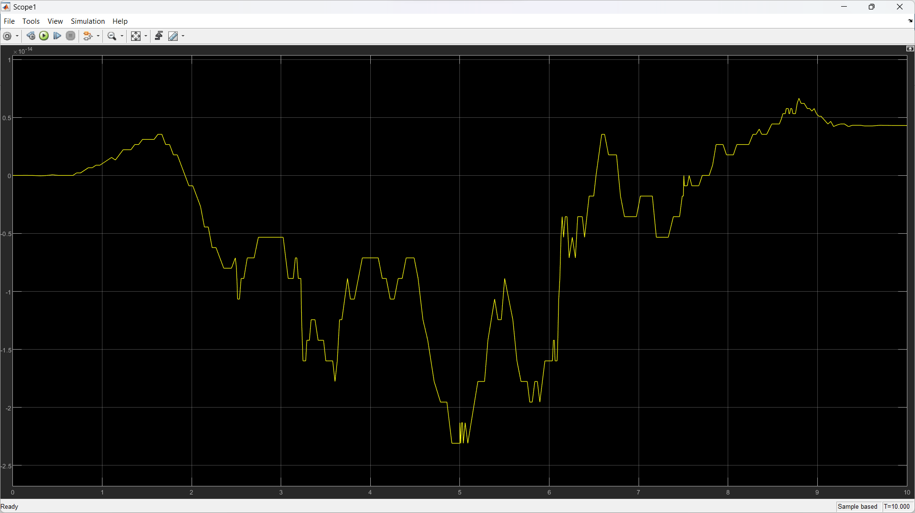
Results & Discussion
Transmission error of the order of 1e-14 rad
MATLAB precision - 16 digits
Even increasing inertia/load does not have much effect on error
Conclusion: Only harmonic drive unlikely to cause vibrations, need some non-ideality (introduced in form of rotational spring)
Fig: Transmission error

Slide 9
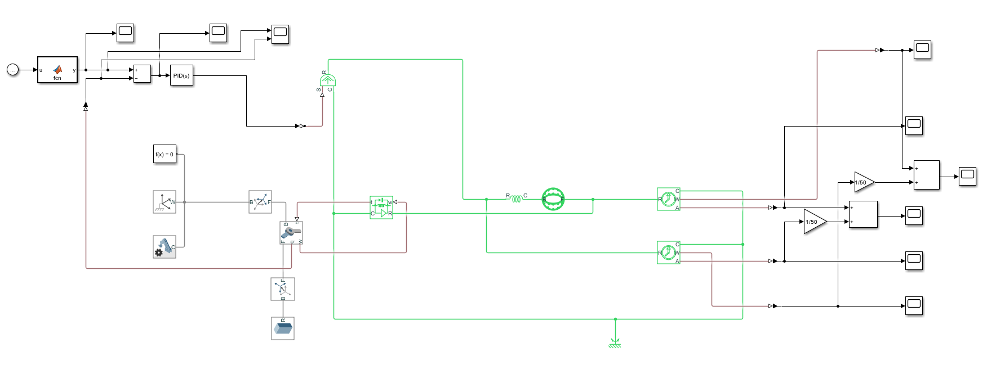
Modeling Harmonic Drive with Rotational Spring
Fig: Simulation of harmonic drive with rotational spring

Slide 10
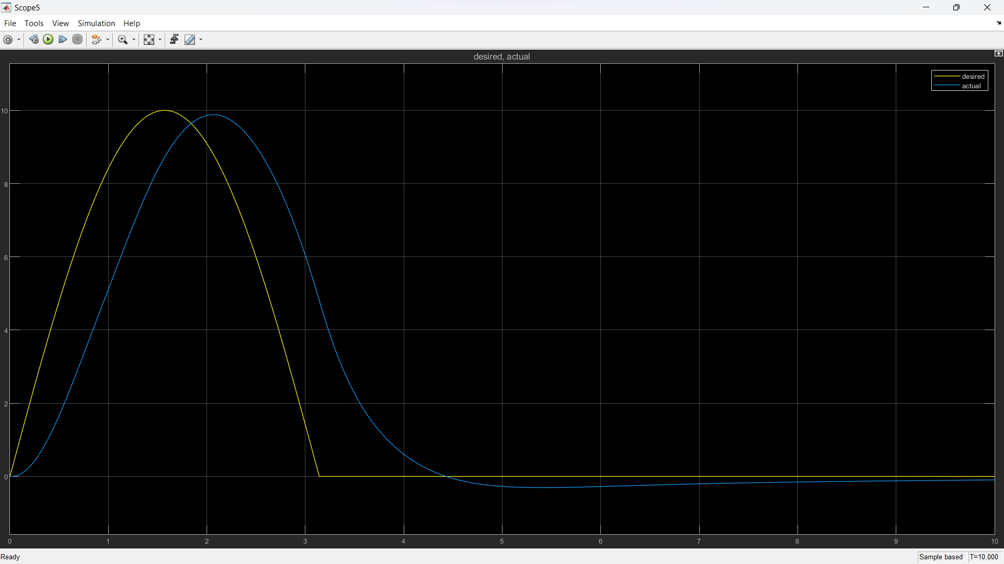
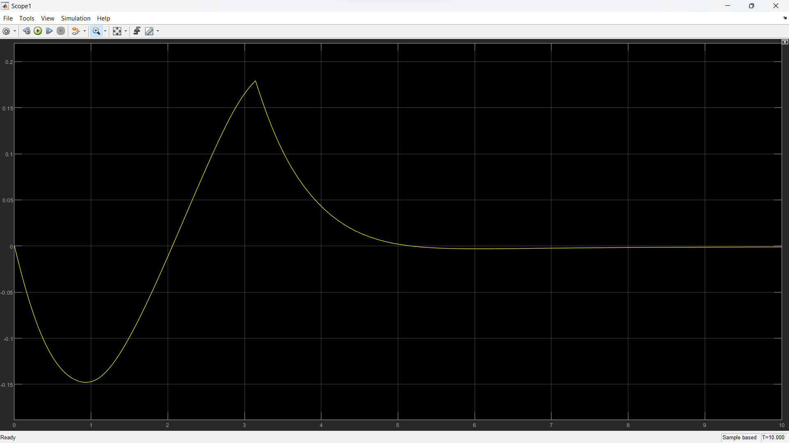
Results
Fig: Angular position tracking
Fig: Transmission error

Slide 11
Discussion
Rotational spring seemed promising
Transmission error: order of 1e-1 rad, but due to input nature
Still did not mimic real world scenario

Slide 12
Harmonic Drive Research
Due to the harmonic drive element in Simscape not giving satisfactory results, we try alternate ways to model it
Xian Zhang, Tao Tao, Gedong Jiang, Xuesong Mei, Chuang Zou. ‘A Refined Dynamic Model of Harmonic Drive and Its Dynamic Response Analysis’ describes a model for the harmonic drive which takes into account the friction, stiffness, and transmission error
Makoto Iwasaki, Hiroyuki Nakamura. ‘Vibration Suppression for Angular Transmission Errors in Harmonic Drive Gearings and Application to Industrial Robots’ describes a two-axis inertia system and a vibration suppression controller, shown on the next slide.

Slide 13
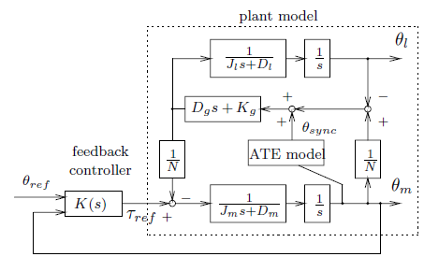
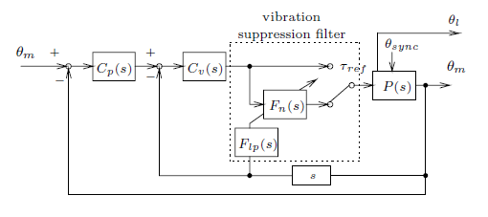
Model Described in Paper
Fig: Two inertia axis system (plant model)
Fig: Vibration suppression controller

Slide 14
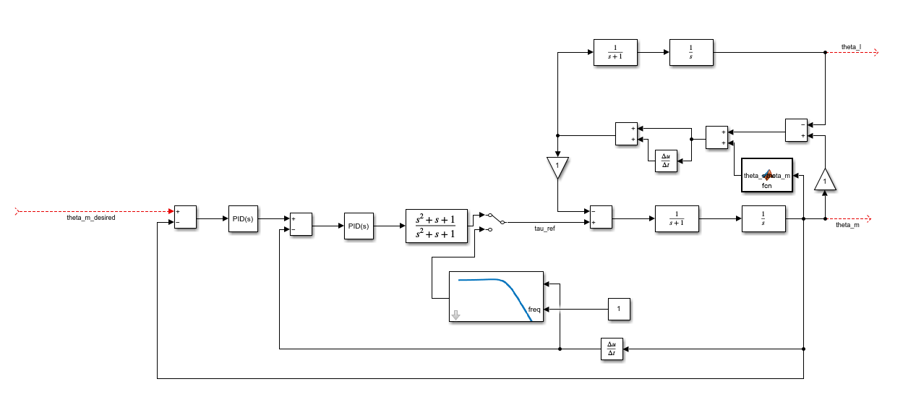
Model Described in Paper (Cont.)
Fig: Simulink model of entire system

Slide 15
Model Described in Paper (Cont.)
Controller consists of:
Variable notch filter to reduce vibrations
Low-pass filter to remove sensor noise
Switching mechanism to control activation of notch filter
Model tested for random inputs, but exact parameter values unknown
Company already using low-pass filter; upon recommendation to use notch filter, vibrations in robotic arm reduced considerably

Slide 16
Modeling the Updated Longest Link Assembly
Though vibration problem was somewhat solved, a simulation base was needed
Created an updated model with:
DC motor
Harmonic drive
Angular position tracking
Rotational spring

Slide 17
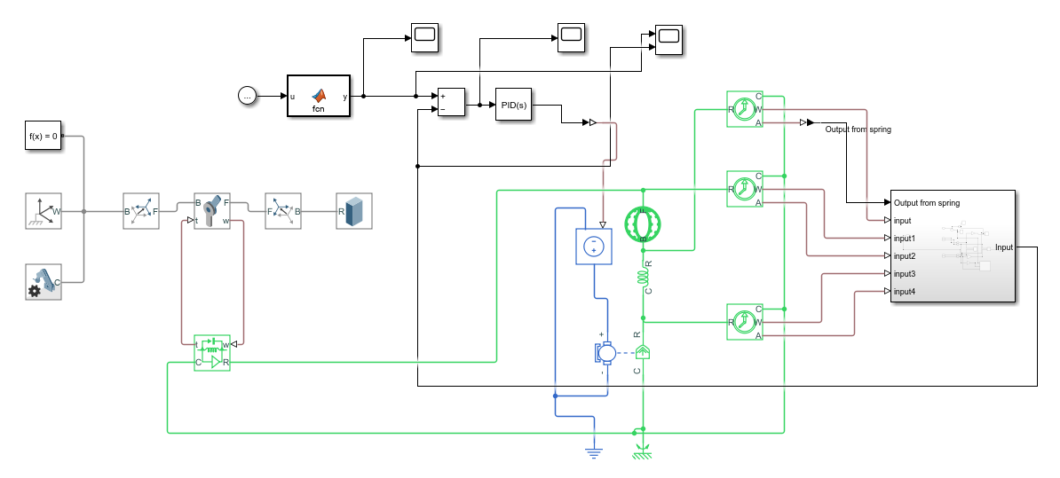
Modeling the Updated Longest Link Assembly (Cont.)
Fig: Updated simscape model

Slide 18
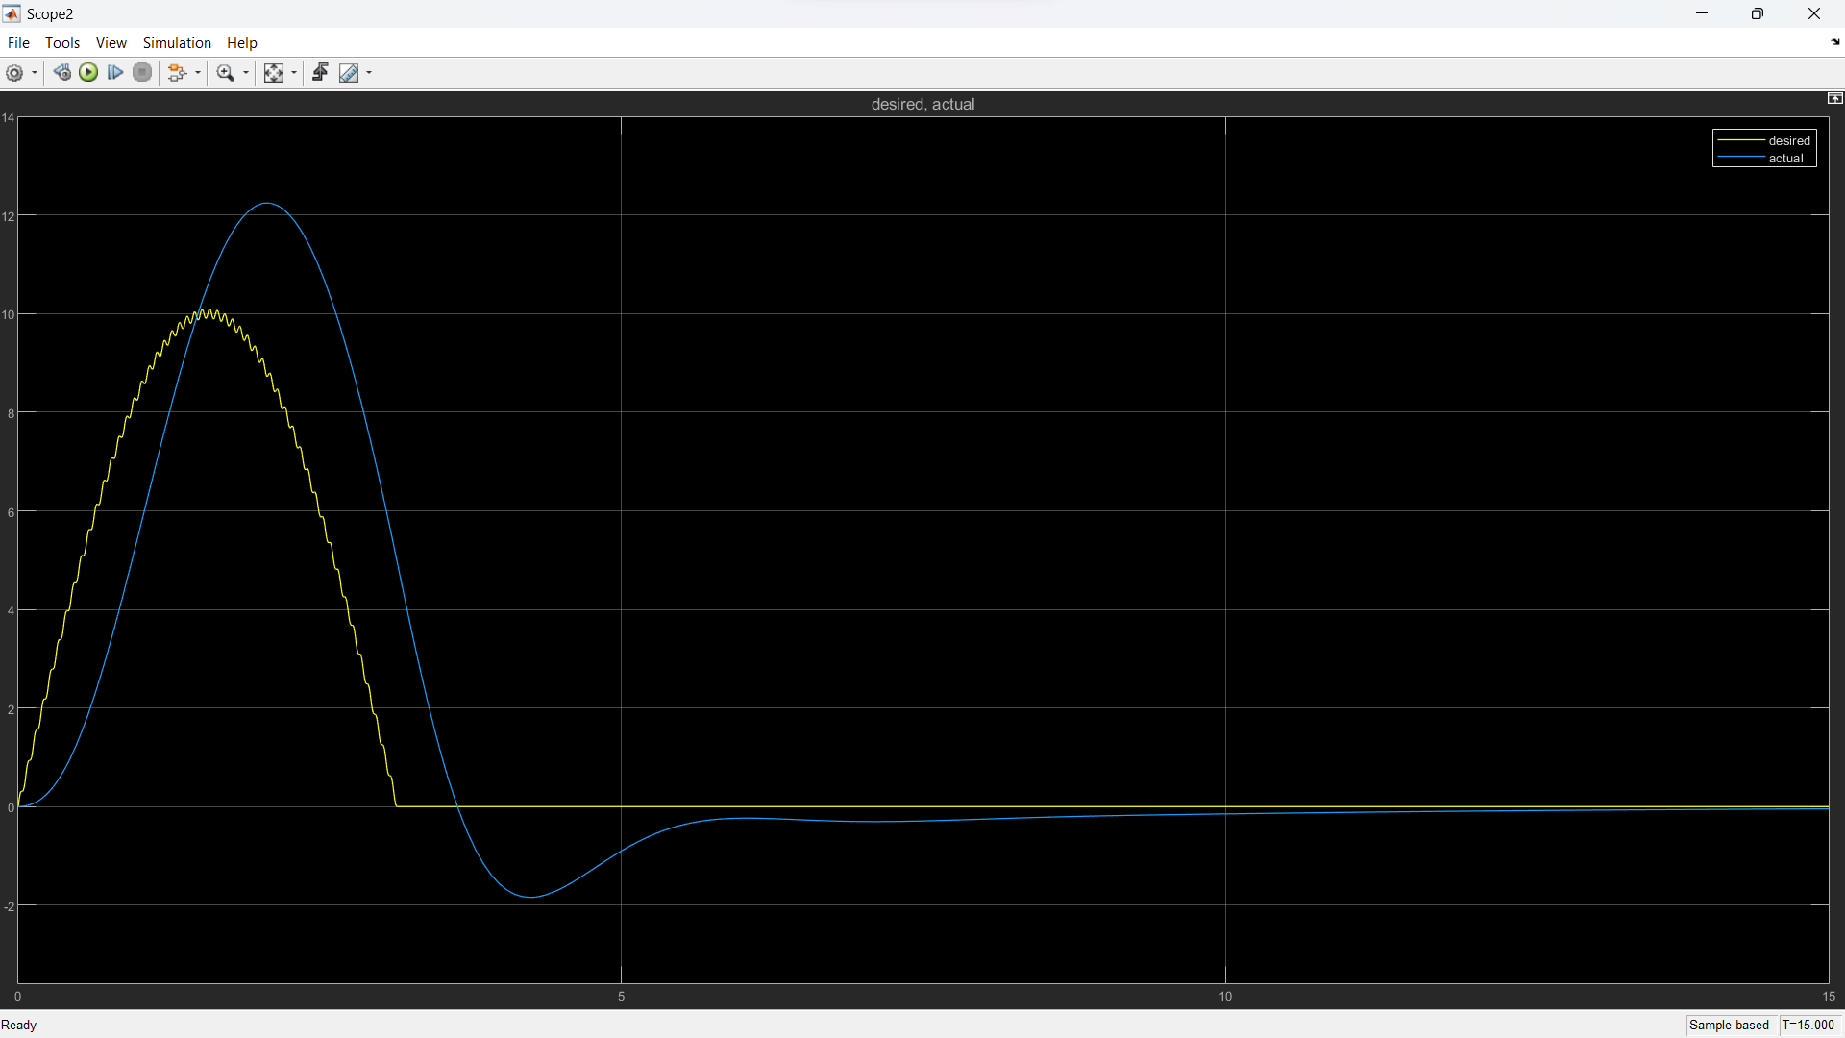
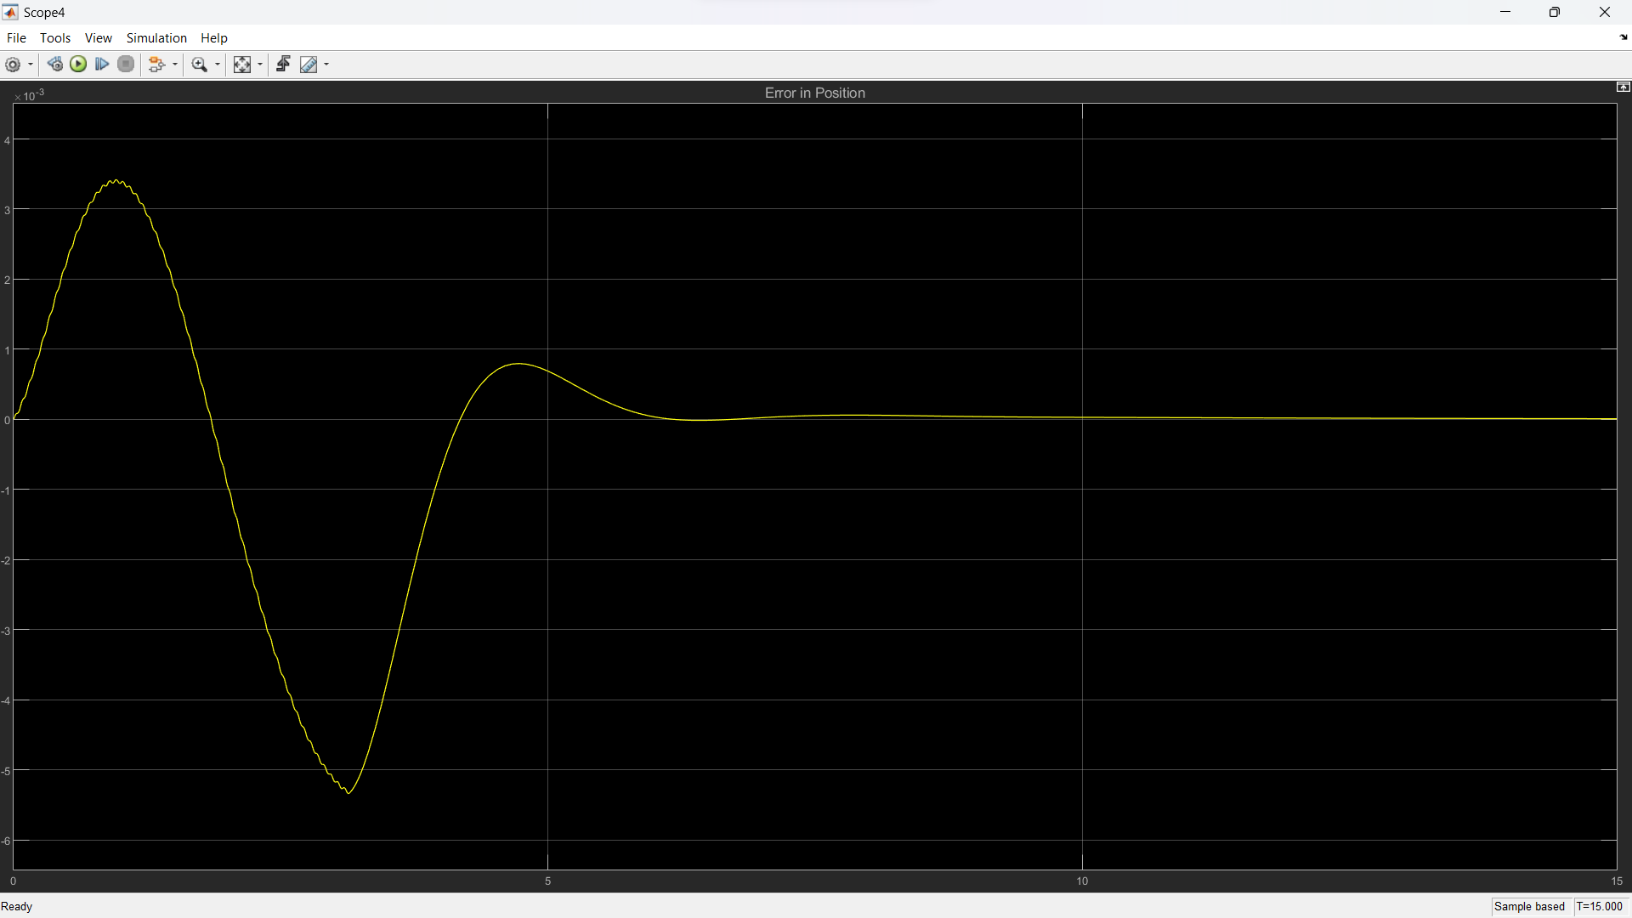
Results
Fig: Angular position tracking
Fig: Transmission error

Slide 19
Discussion
Position feedback was taken right from motor instead of revolute joint (as done before) which resembles the real world scenario
Transmission error significant, but still no vibrations
Conclude that only harmonic drive may not be the cause of vibrations, have to introduce BLDC motor as well

Slide 20
Modeling the BLDC Motor
Studied BLDC motors and field oriented control
Referred to readymade Simulink models of BLDC motors to understand better
Model needed new components like three-phase inverter, the BLDC motor itself, commutation logic, PWM controller, etc.

Slide 21
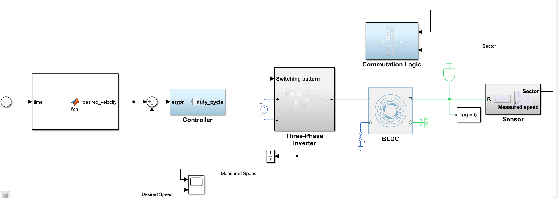
Modeling the BLDC Motor (Cont.)
Fig: Velocity tracking model with BLDC motor

Slide 22
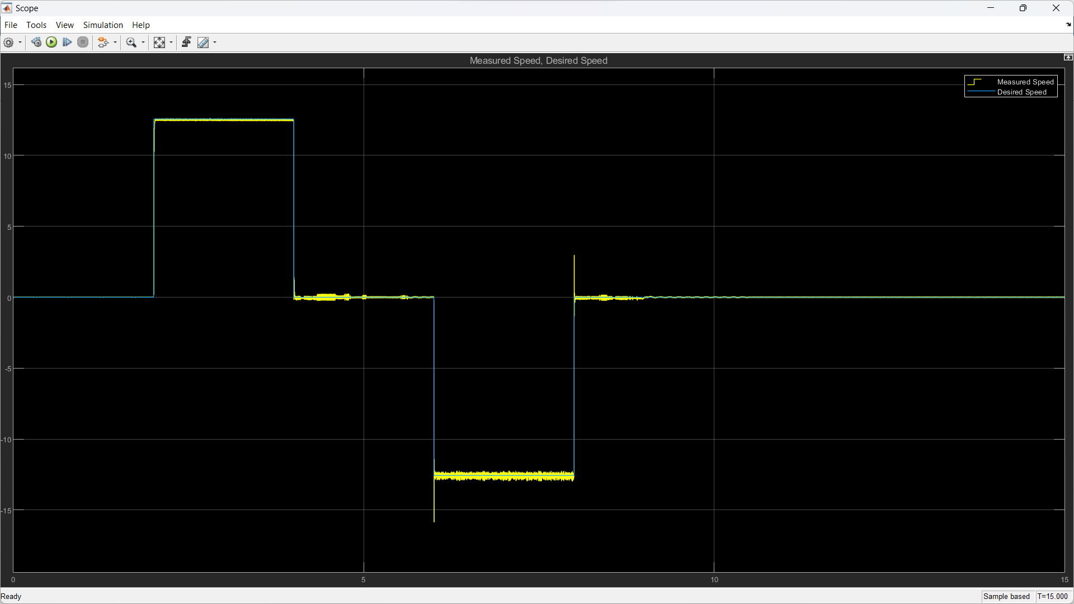
Results & Discussion
BLDC motor even without harmonic drive and added noise shows vibrations
Next step: combine BLDC motor with harmonic drive
Fig: Velocity tracking

Slide 23
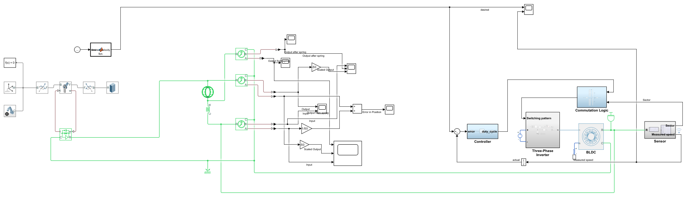
Modeling BLDC Motor with Harmonic Drive & Load
Fig: Simscape model of entire assembly using BLDC motor, harmonic drive and load

Slide 24
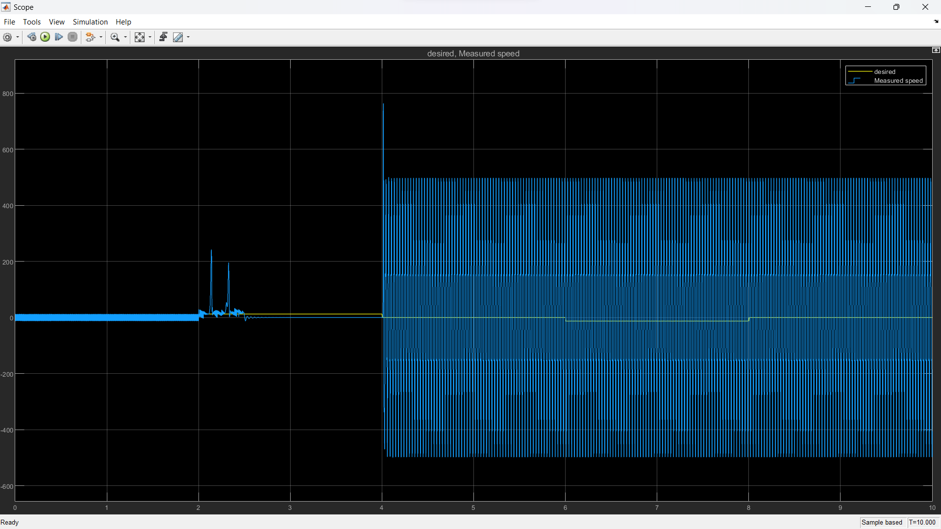
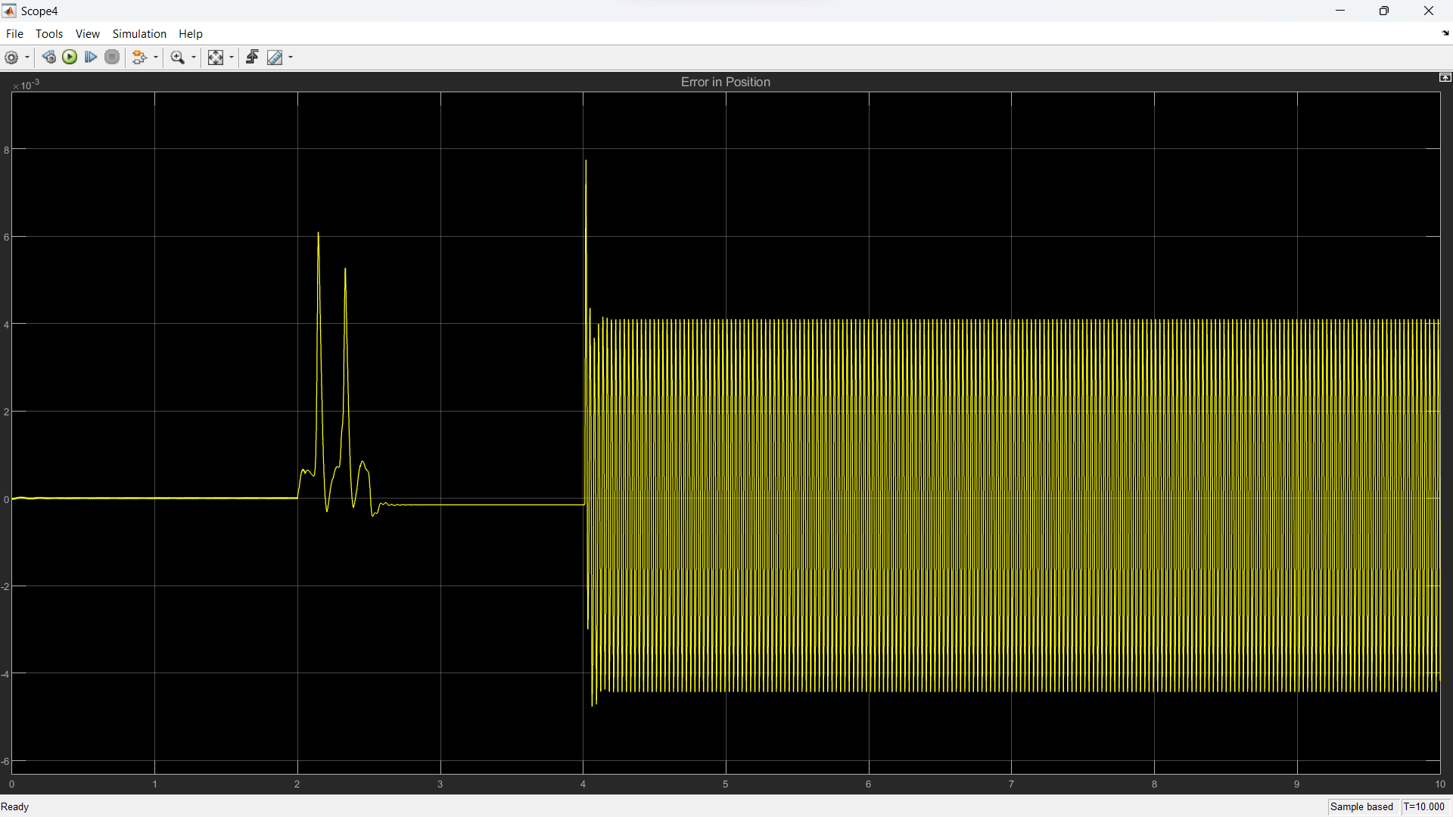
Results
Fig: Velocity tracking
Fig: Transmission error

Slide 25
Discussion
Transmission error: order of 1e-3 rad, significant enough to cause vibrations
Velocity characteristics haywire
Notch filter best bet

Slide 26
Input Shaping for Vibration Reduction
Input shaping: feedforward method to reduce vibrations in robotic arms, especially at end effector
Dan Kielsholm Thomsen, Rune Soe-Knudsen, Ole Balling, Xuping Zhang. ‘Vibration control of industrial robot arms by multi-mode time-varying input shaping’ provides a comprehensive procedure to implement input shaping for a robotic arm
Multi-Mode Time-Varying Input Shaping Technology (TVIST) was established as the best way to dampen vibrations

Slide 27
Input Shaping Model
Components: DC motor, harmonic drive, rotational spring, rotational damper, aluminium bar, PID control loop
Velocity tracking done via PID control loop
Loads applied at end of aluminium bar
To mimic real world, some random noise was also added

Slide 28
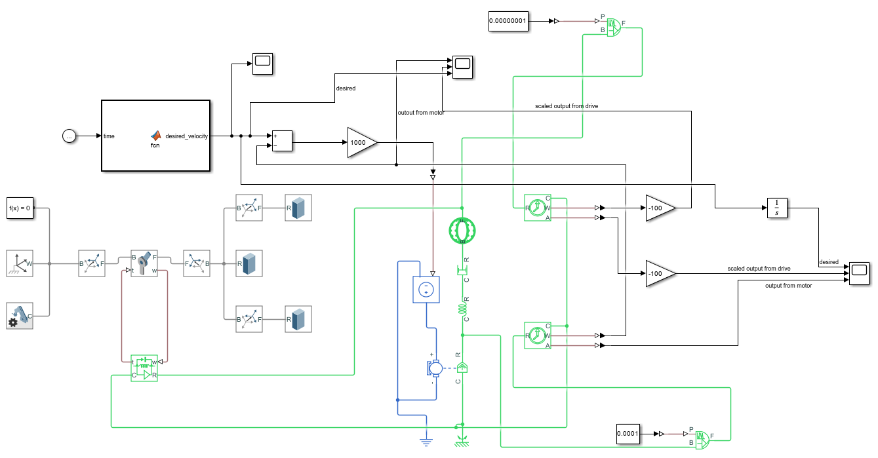
Input Shaping Model (Cont.)
Fig: Combined model for studying input shaping

Slide 29
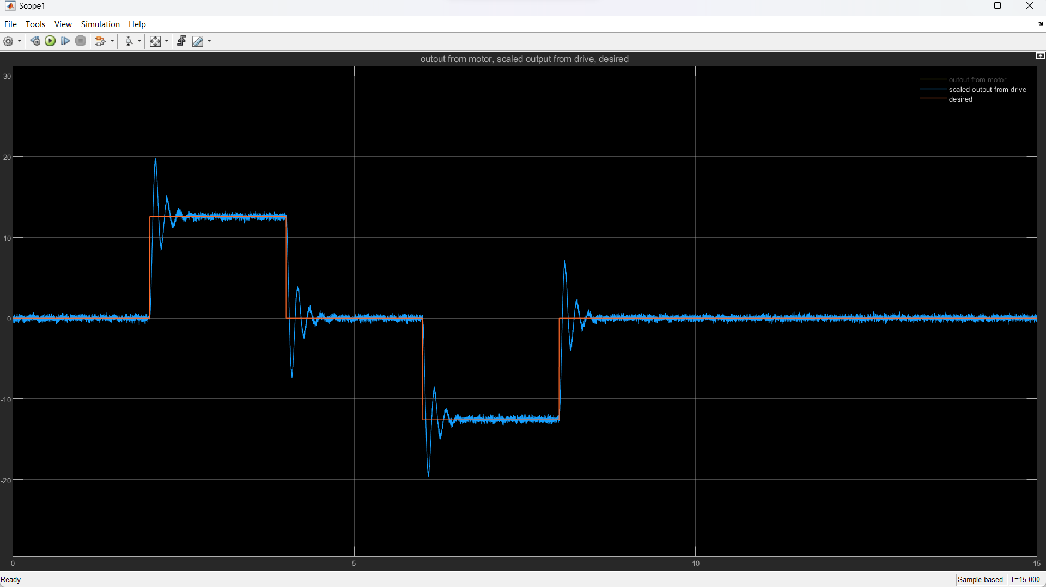
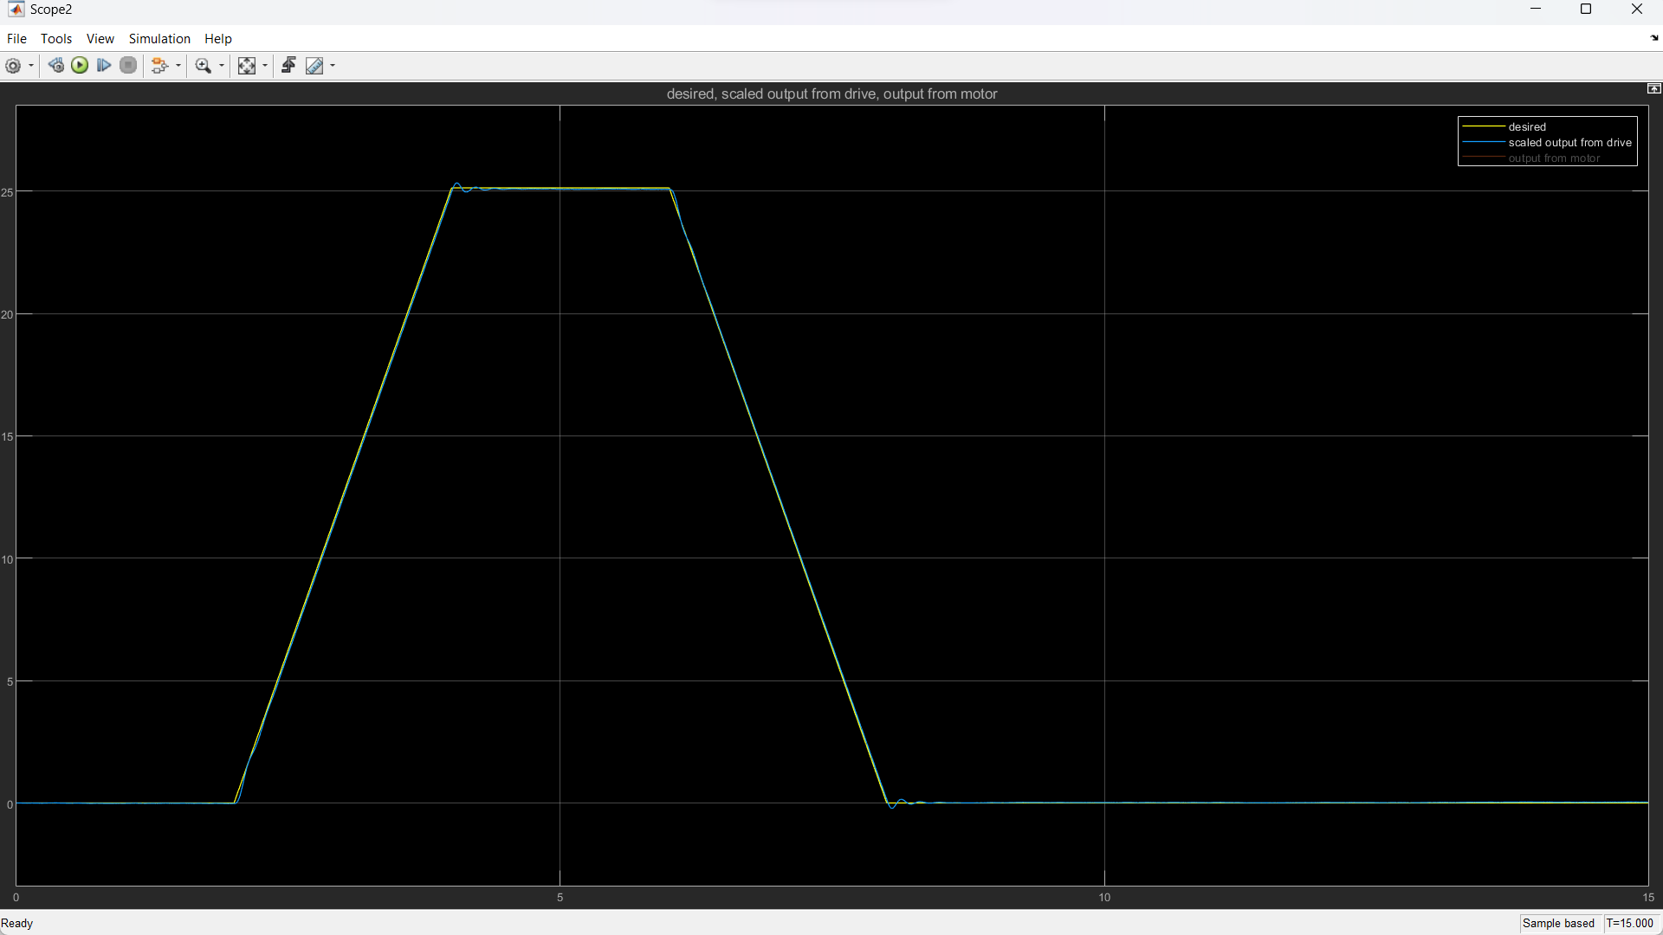
Results
Fig: Velocity tracking
Fig: Desired (yellow) and actual (blue) positions

Slide 30
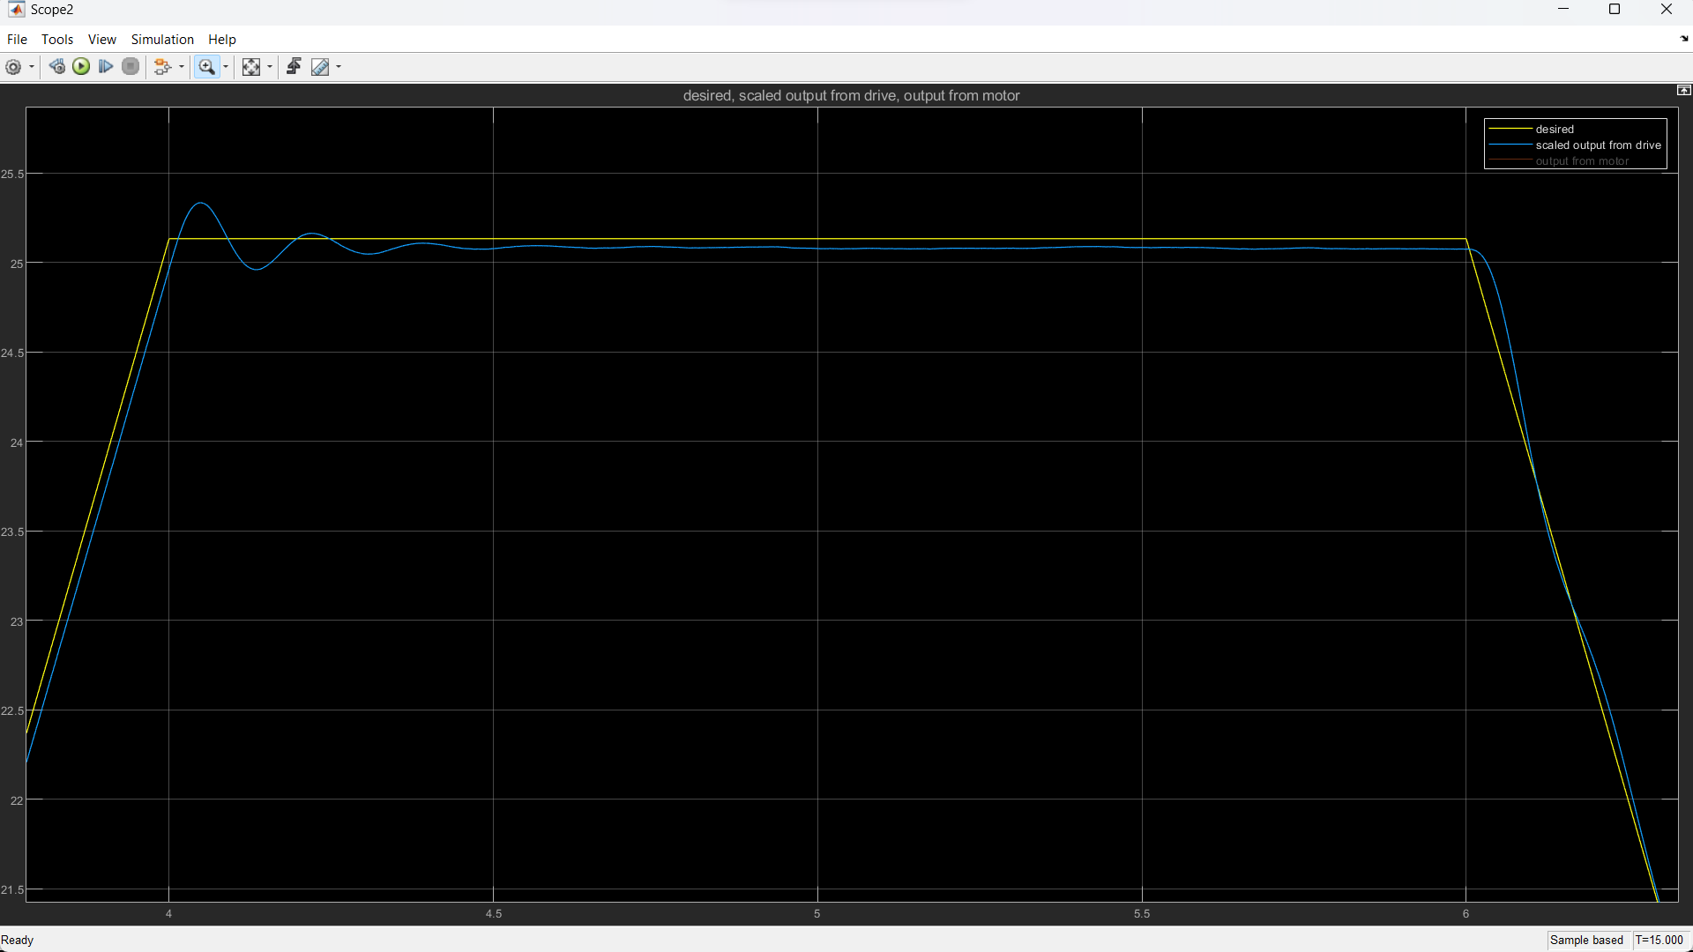
Results & Discussion
Results match the real-world behaviour exactly
Next steps: Apply multi-mode TVIST and see if oscillations cease
Fig: Desired and actual positions (zoomed in)

Slide 31
Robot Hardware Testing
Since the startup had products lined up, they needed help testing the robot software and hardware
Assembled and tested hardware at the company warehouse and performed limit tests and speed tests to ensure the pieces were fit to go to market
Performed some basic communication and app based tasks

Slide 32
Communication System for Robot
Similar to pub-sub in ROS, a server for publishing and a client for subscribing was set up using the pyzmq library
Rate of publishing, message filter, etc. can be changed
An application was set up using Streamlit library on the local machine
The data received by the client was plotted against time, and the plot could be started and stopped at any time using the buttons
Finally, an interface was created with buttons for various tests of the robot, which prints the status of the robot every 1 second

Slide 33
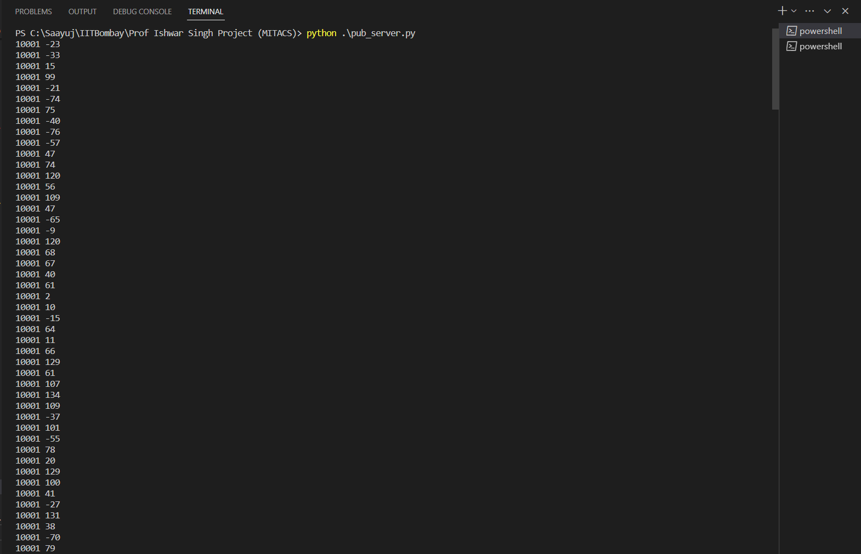
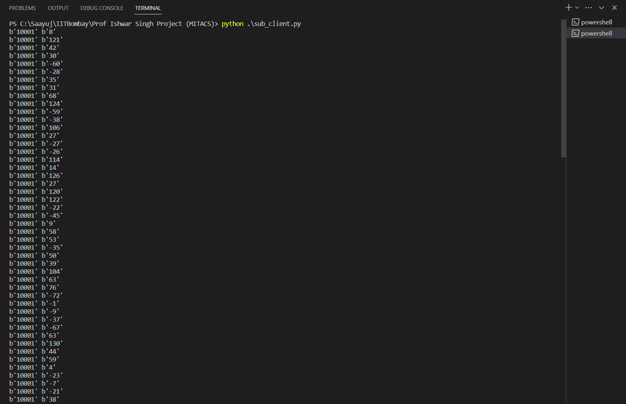
Server & Client
Fig: Server publishes data in this format
Fig: Client receives data in this format

Slide 34
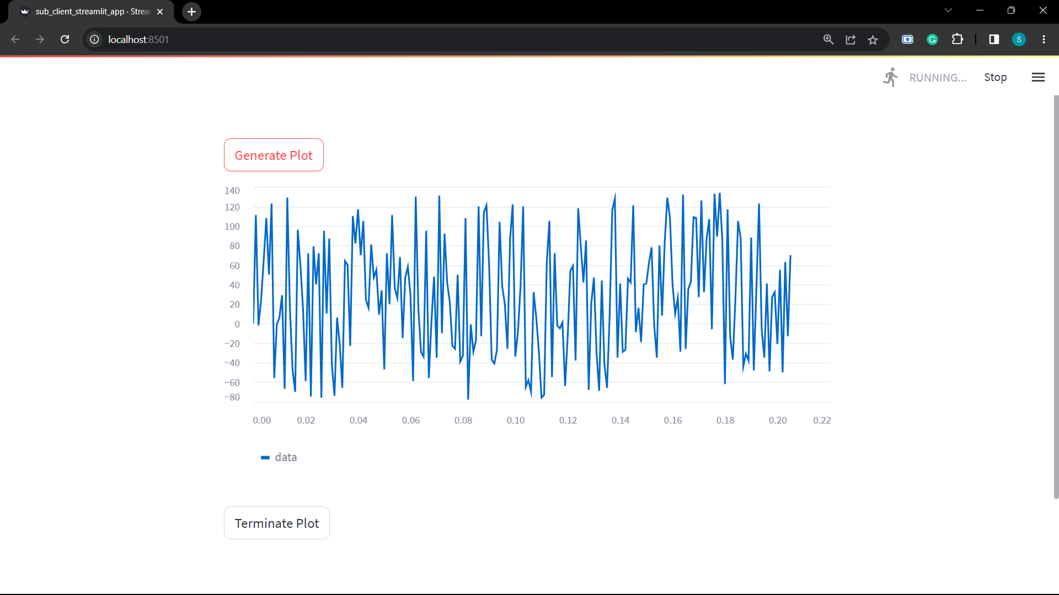
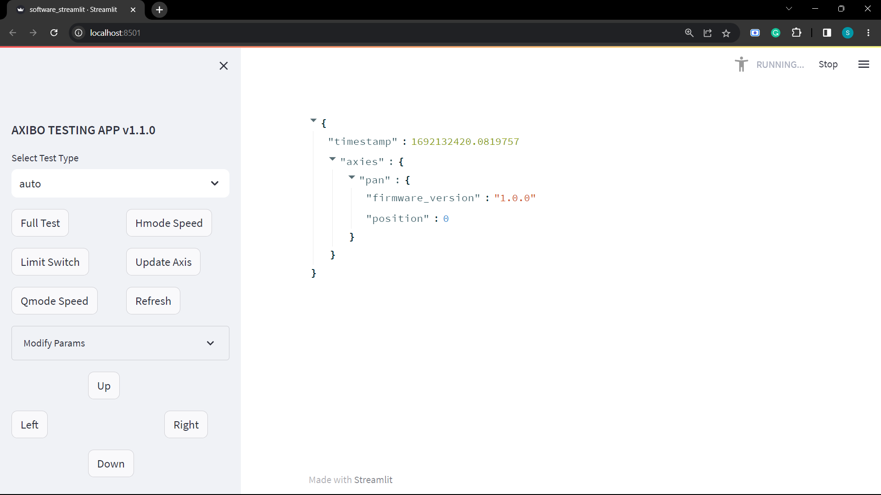
Application
Fig: Constantly updating plot with data from server
Fig: Testing application

